Slide 1

Hypothesis Testing
Robert Johnson

Slide 2
Overarching Problem
Outlier Detection
Outlier detection aims to detect anomalies in the data
What is an outlier?
An exact definition of an outlier depends on the application
Some examples of a broad definition include:
“an outlier is an observation which deviates so much from other observations as to arouse suspicions that it was generated by a different mechanism” [Hawkins 1980]
“an outlier observation is one that appears to deviate markedly from other members of the sample in which it occurs” [Barnett and Lewis 1994]
Notes:
Before we look at hypothesis testing let’s first look at what problem it is trying to solve
Outlier detection aims to detect anomalies in the data
What is an outlier?
In order to detect an outlier in the data there must be some definition of what a normal data value is to contradict the outlier
The exact definition of what an outlier is depends on the applications and methods you choose to use to analyze the dataset.
Some examples of a broad definition are included in the slide

Slide 3
Potential Challenges
Defining normal data patterns
Ex, wearable sensors vs salary
The curse of dimensionality
Increasingly difficult to accurately estimate distribution
Distances between points approach zero
Picking the right method
Distance-based, Model-Based, and Statistics-Based
Understand the assumptions and limitations of each method
Notes:
Detecting outliers comes with many challenges
To start defining normal data patterns can be tricky, for example wearable sensors may have spikes in their data that are not outliers since they fall within a specific range dictated by the sensors, whereas spikes found in salary values are likely outliers
Secondly, as the number of dimensions a dataset has grows larger many detection techniques become less and less effective, this happens for two reasons
One, it becomes increasingly difficult to accurately estimate multidimensional datasets as their dimensions increase
Two, the distances between the points of data get smaller and smaller as the dimensions increase losing their potential meaning in the process
Knowing these things we must determine which method is best suited to our problem domain, there are three main categories of detection methods each with their own subcategories: distance-based, model-based, and the category we’re focusing on statistics-based
Each of these methods mainly differs in how they define normal data patterns, and come with their own unique assumptions and limitations

Slide 4
Statistics-Based Methods
Assumptions
Normal data points appear in high probability region
Outliers appear in low probability region
Subcategories
Hypothesis Testing
Fitting Distribution
Advantages
Can provide a statistical interpretation for the outliers
Generally, are unsupervised
Limitations
Generally, rely on the assumption that the data is generated from a specific distribution
As dimensionality grows, constructing and choosing the best tests becomes harder as well
Notes:
This is not meant to be a in depth discussion on Statistics-based methods but more a broad overview
Picking up from the last slide, we know we must evaluate the assumptions and limitations of a method before using it
A statistics-based method makes two, intuitive, assumptions:
One, normal data points would appear in the high probability region of a stochastic model
Two, outliers occur in the low probability region of a stochastic model
There are two main subcategories of statistics-based methods
Hypothesis Testing which we will discuss further later
The second subcategory is fitting a distribution, which in a very brief overview, involves trying to infer a probability density function based on the given data and using that to determine outliers. This method has its own set of subcategories for approaching it as well.
So when are good times to use statistics-based methods
When the underlying data follows a specific distribution, such as a normal distribution, statistics-based methods can provide a statistical interpretation for the outliers
Typically statistics-based methods are unsupervised learning methods that operate on unlabeled data
Lastly, what limitations do statistics-based methods have
Typically these methods rely on the assumption that the data follows a specific distribution, which is generally is not the case in real world data especially as dimensionality rises
In particular the curse of dimensionality is a large limitation for these methods, as dimensionality grows larger, the task of deciding which test statistics (which there are generally many justifiable options to choose from) becomes harder, not to mention that constructing hypothesis tests for complex distributions (which are used to fit these high dimensional datasets) can be a difficult task

Slide 5
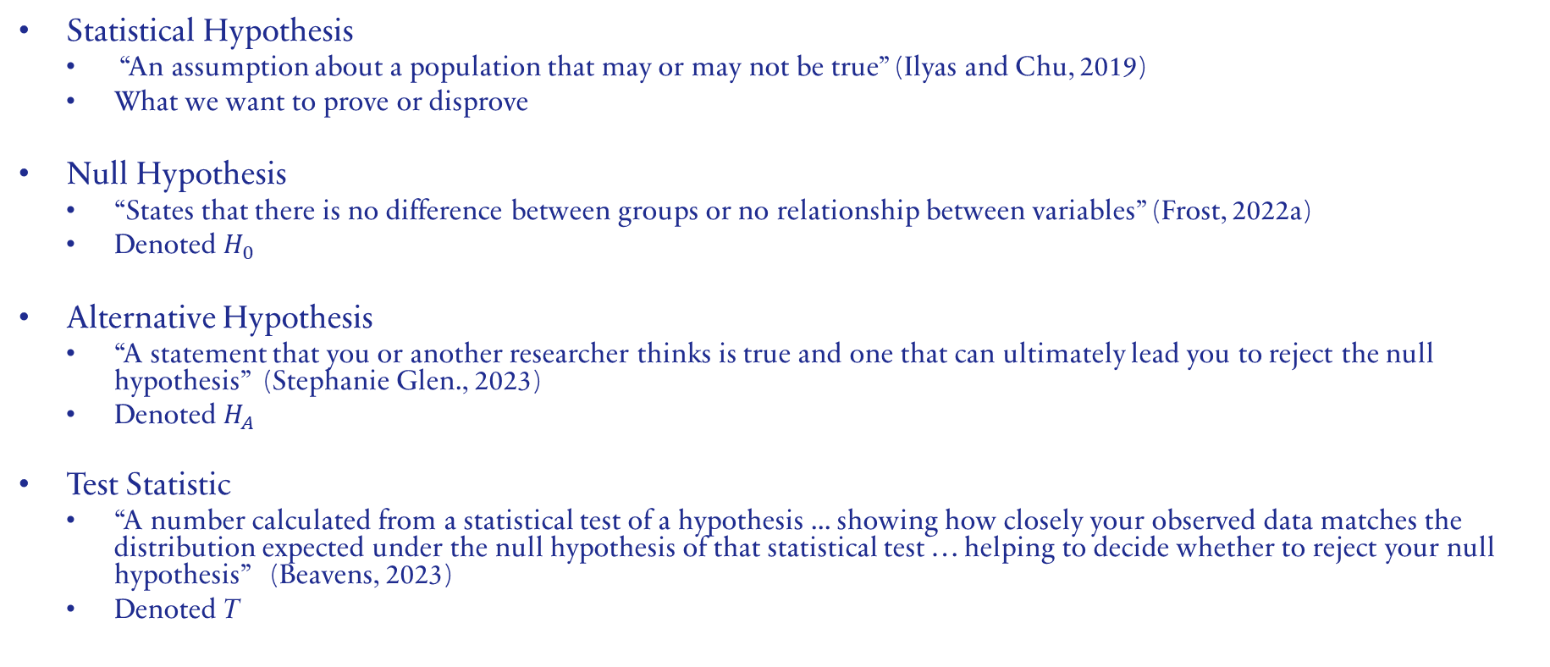
Hypothesis Testing: Vocabulary
Statistical Hypothesis
“An assumption about a population that may or may not be true” (Ilyas and Chu, 2019)
What we want to prove or disprove
Null Hypothesis
“States that there is no difference between groups or no relationship between variables” (Frost, 2022a)
Denoted $H_{0}$
Alternative Hypothesis
“A statement that you or another researcher thinks is true and one that can ultimately lead you to reject the null hypothesis” (Stephanie Glen., 2023)
Denoted $H_{A}$
Test Statistic
“A number calculated from a statistical test of a hypothesis ... showing how closely your observed data matches the distribution expected under the null hypothesis of that statistical test … helping to decide whether to reject your null hypothesis” (Beavens, 2023)
Denoted T
Notes:
Finally to the main topic, let's start with a brief overview of some vocabulary before diving in
Statistical Hypothesis; the book provides us with a nice brief definition for a statistical hypothesis
We formulate statistical hypothesis in order to test them
Null Hypothesis; all statistical studies aim to determine an effect or in our case a relationship between variables, we call the case that no effect or relationship exists the null hypothesis, this hypothesis is assumed as correct until enough evidence exists to disprove it
For our purposes the null hypothesis is that no outliers exist
Alternative Hypothesis; The alternative hypothesis is then simply the case that an effect or relationship between variables does exist, if we have enough evidence we can reject the null hypothesis and accept the alternative hypothesis
For us this means that an outlier exists
Test Statistic; The test statistic summarizes your observed data into a single number, in short it is generally calculated as the pattern in your data (i.e. correlation) divided by the variance in your data (i.e. standard variation), and is used to determine how likely an observed result would be if the null hypothesis were true

Slide 6
Hypothesis Testing: Vocabulary
Significance level
“A probability threshold below which the null hypothesis will be rejected” (Ilyas and Chu, 2019)
Denoted 𝛼
Critical Region
“The range of values of the test statistic for which the null hypothesis is rejected” (Ilyas and Chu, 2019)
Hypothesis Testing
“The formal procedures used by statisticians to accept or reject statistical hypotheses” (Ilyas and Chu, 2019)
Notes:
Significance level; Basically a threshold that t must surpass in order to be considered statistically significant and you can reject the null hypothesis
Critical Region; essentially a set of values for the test statistic that would lead to rejecting the null hypothesis
Finally, Hypothesis Testing itself; Hypothesis testing refers to the actual steps we must go through to accept or reject these hypotheses mentioned above

Slide 7
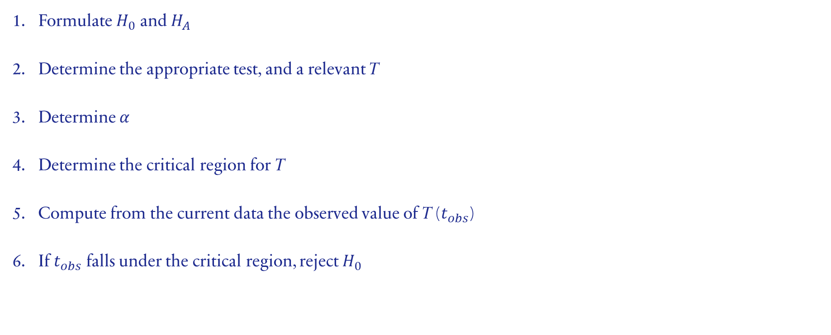
Hypothesis Testing: Steps
Formulate $H_{0}$ and $H_{A}$
Determine the appropriate test, and a relevant T
Determine 𝛼
Determine the critical region for T
Compute from the current data the observed value of T ($t_{obs}$)
If $t_{obs}$ falls under the critical region, reject $H_{0}$
Notes:
These are the formal steps that typically make up the process of hypothesis testing
First we must formulate the null and alternative hypotheses, remember these are what we are attempting to prove or disprove, the null hypothesis of no relationship is assumed until enough evidence for the alternative hypothesis exists
Secondly, we must determine which test best suites our problem domain furthermore, differing test statistics exist to test different properties of a population we must determine which of these is relevant to us
Thirdly, we choose a significance level alpha, standard alpha value is 0.05, in order to deviate from that value you will typically need a good reason, keep in mind significance level and required evidence are inverse of each other, that is if you raise the significance level you will require less evidence to reject the null hypothesis and your test will be more sensitive to differences, however it will be more susceptible to false negatives (Frost, 2022b), another way to look at it is for an alpha value of 0.05 your confidence level is 95% that your results are significant
Fourth we determine a critical region for the test statistic, this is done using alpha
Next, using the current data compute the observed value of the test statistic this is denoted t obs
If t obs is within the critical region then we reject the null hypothesis in favor of the alternative hypothesis

Slide 8
Hypothesis Testing: Formal Examples
Grubbs Test
One outlier
Tietjen-Moore Test
Specified number of outliers
The Generalized Extreme Studentized Deviate (ESD) Test
Upper bound on suspected number of outliers
Notes:
The following are a couple examples of formal hypothesis tests for detecting outliers

Slide 9
Citations
Ilyas, I. F., & Chu, X. (2019). Statistics-Based Outlier Detection. In Data Cleaning. essay, Association for Computing Machinery.
Frost, J. (2022a, November 7). Null hypothesis: Definition, rejecting &amp; examples. Statistics By Jim. https://statisticsbyjim.com/hypothesis-testing/null-hypothesis/
Stephanie Glen. (2023, March 3). Alternate hypothesis in statistics: What is it?. Statistics How To. https://www.statisticshowto.com/what-is-an-alternate-hypothesis/
Bevans, R. (2023, June 22). Test statistics | Definition, Interpretation, and Examples. Scribbr. Retrieved September 25, 2023, from https://www.scribbr.com/statistics/test-statistic/
Frost, J. (2022b, November 7). Understanding significance levels in statistics. Statistics By Jim. https://statisticsbyjim.com/hypothesis-testing/significance-levels/

